Slide 1
Introduction to Power BI
Feb 25th 2020

Slide 2


Your Presenter
Suresh Datla
Enterprise Data Architect and Practice Director

Slide 3
About me
In the industry for 20 years working on Microsoft stack
Data space full time 10 years (Certified in SQL Server since 2001)
Azure cloud since inception(8 years)
Power BI Since inception (4years since GA)

Slide 4
Technical Community
Orange County Power BI User Group(Organizer)
SQL Saturday Redmond (Speaker)
SQL Saturday San Diego(Speaker)
SQL Saturday Los Angeles(Speaker)
SQL Saturday Orange County(Speaker)
SQL Saturday Sacramento(Speaker)

Slide 5
The Evolution of BI
3rd wave End user BI
Everyone
2nd wave Self-service BI
Analyst to end user
1st wave Corporate BI
IT to end user
Notes:
The way business intelligence is used in organization has changed significantly over the years. One way of understanding these changes is using the analogy of these three waves of BI:
In the early days of BI, organizations would typically have a team or person handling all the requests for insights from the business. This model is not very scalable, and it can take a long time for the answer to get back to the user. By the time it does, a new question probably has already come up.
To solve for this lack of scalability and gap between BI team and end users, the second approach to BI was to get BI capabilities in the hands of analysts, who understand the business and are able to support decisions with analytics.
With Power BI, we want to enable everyone in the organization to analyze their data, ask the questions will help them run their business better, and act based on the insights they find.

Slide 6
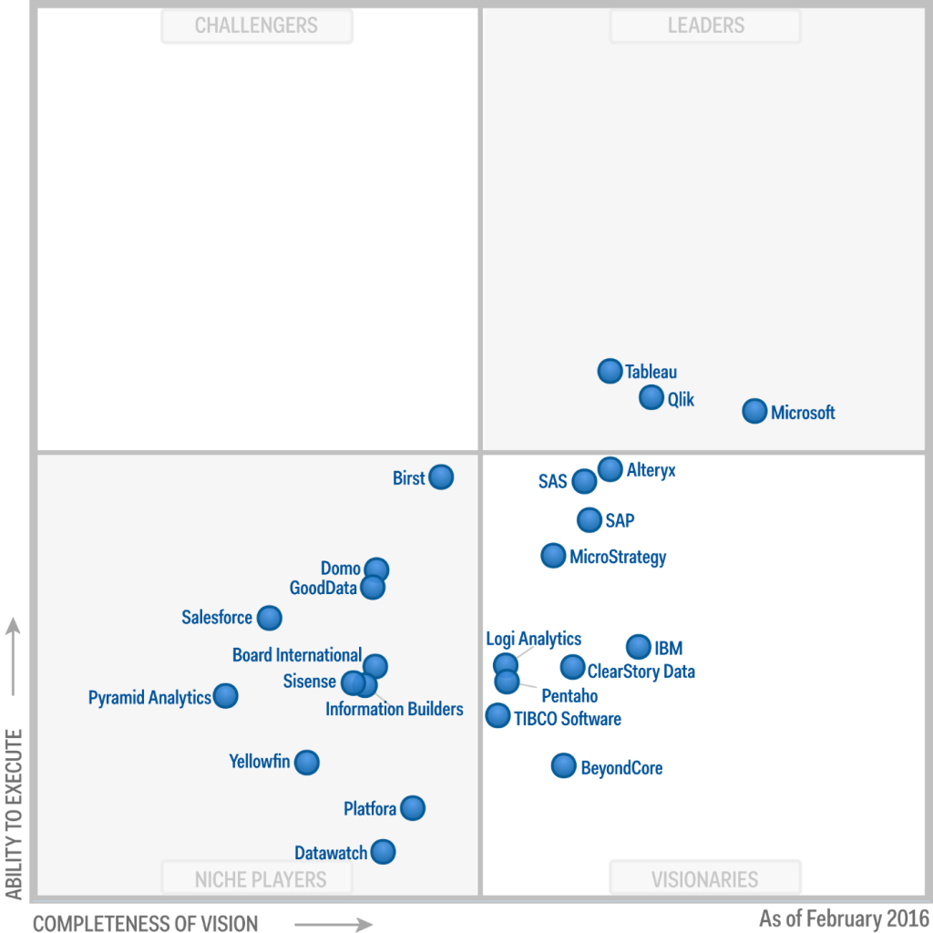

Slide 7
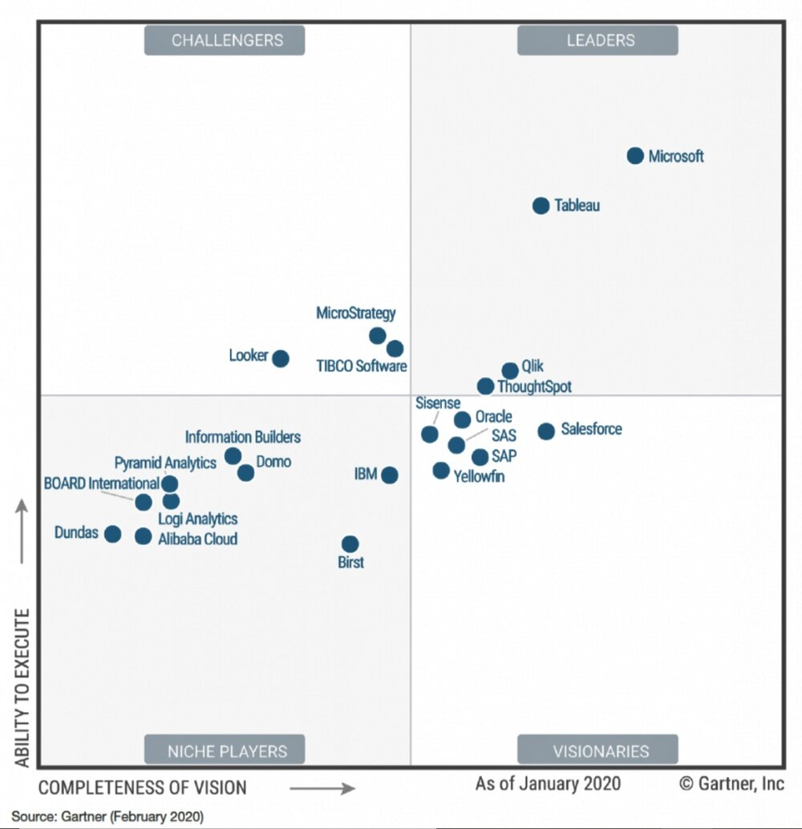

Slide 8
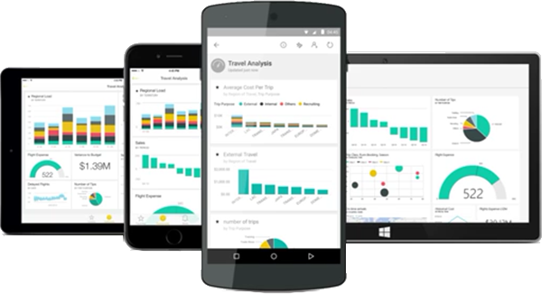
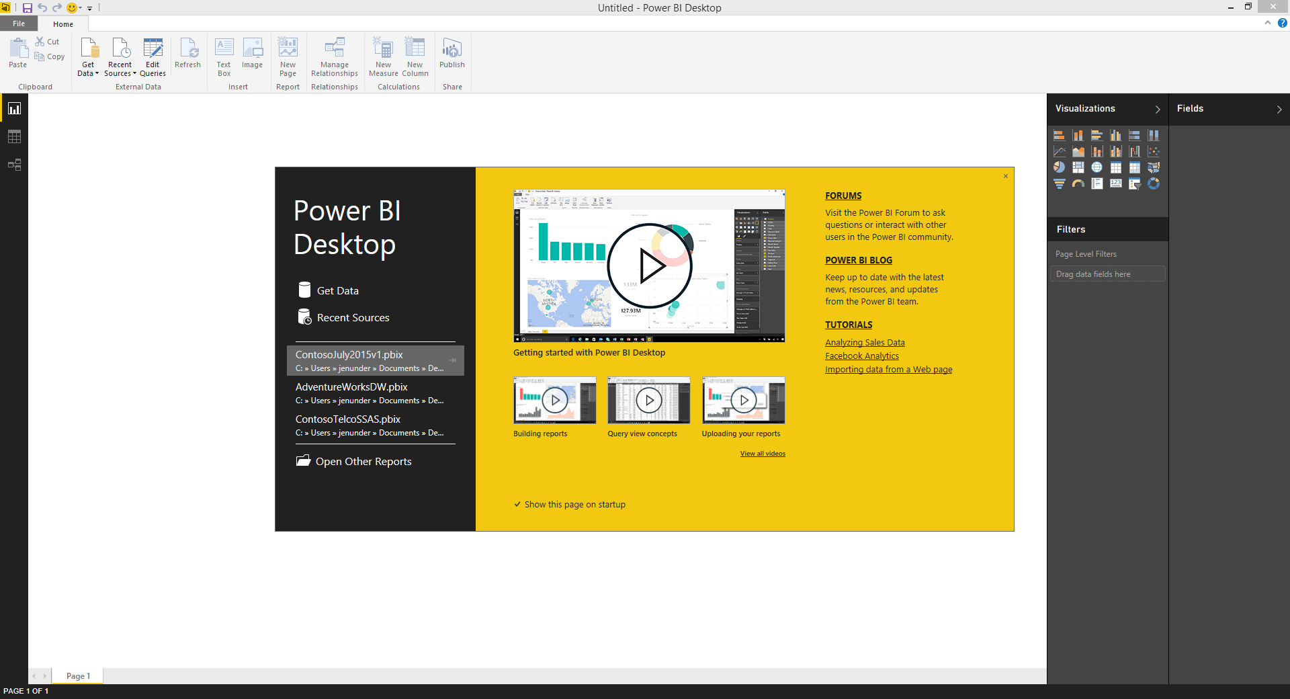
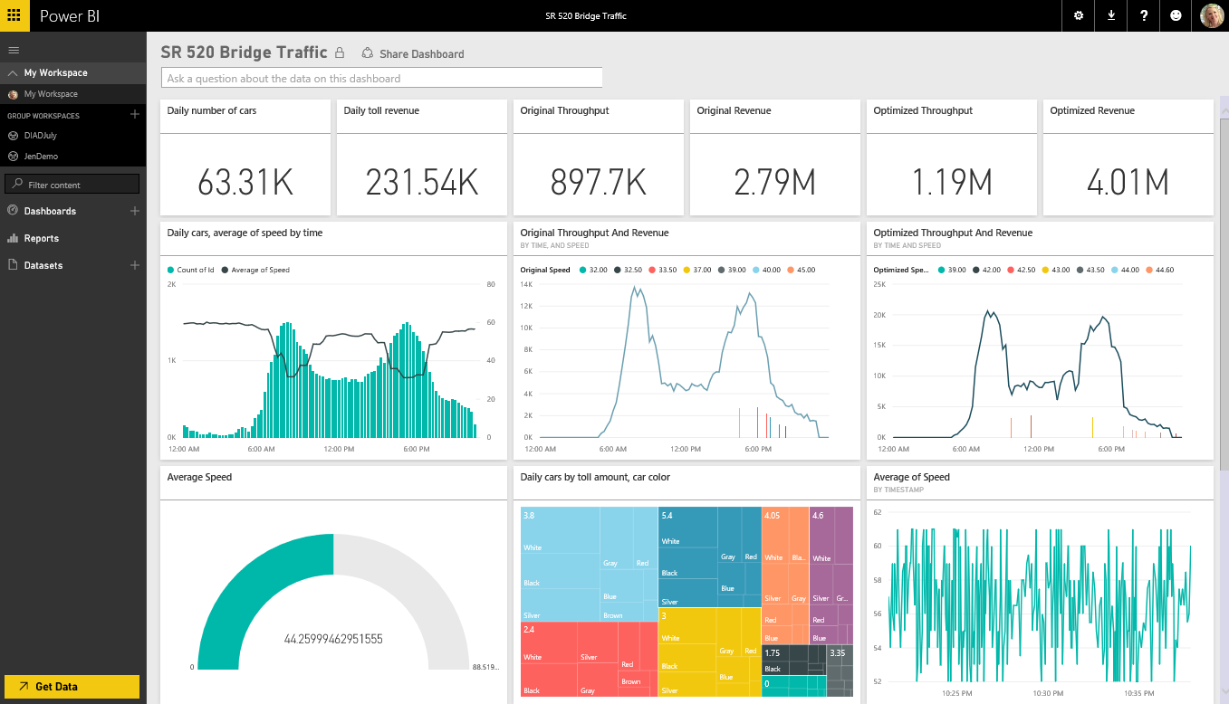
Power BI - Basics
Mobile Apps for iOS, Android and Windows
Power BI Desktop
PowerBI Service

Slide 9
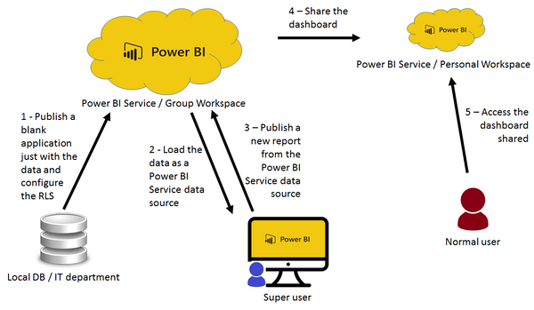
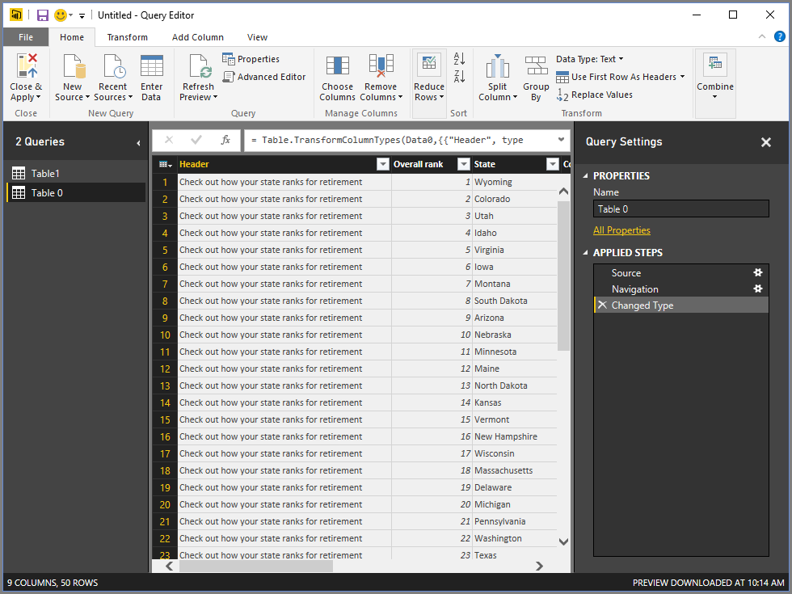

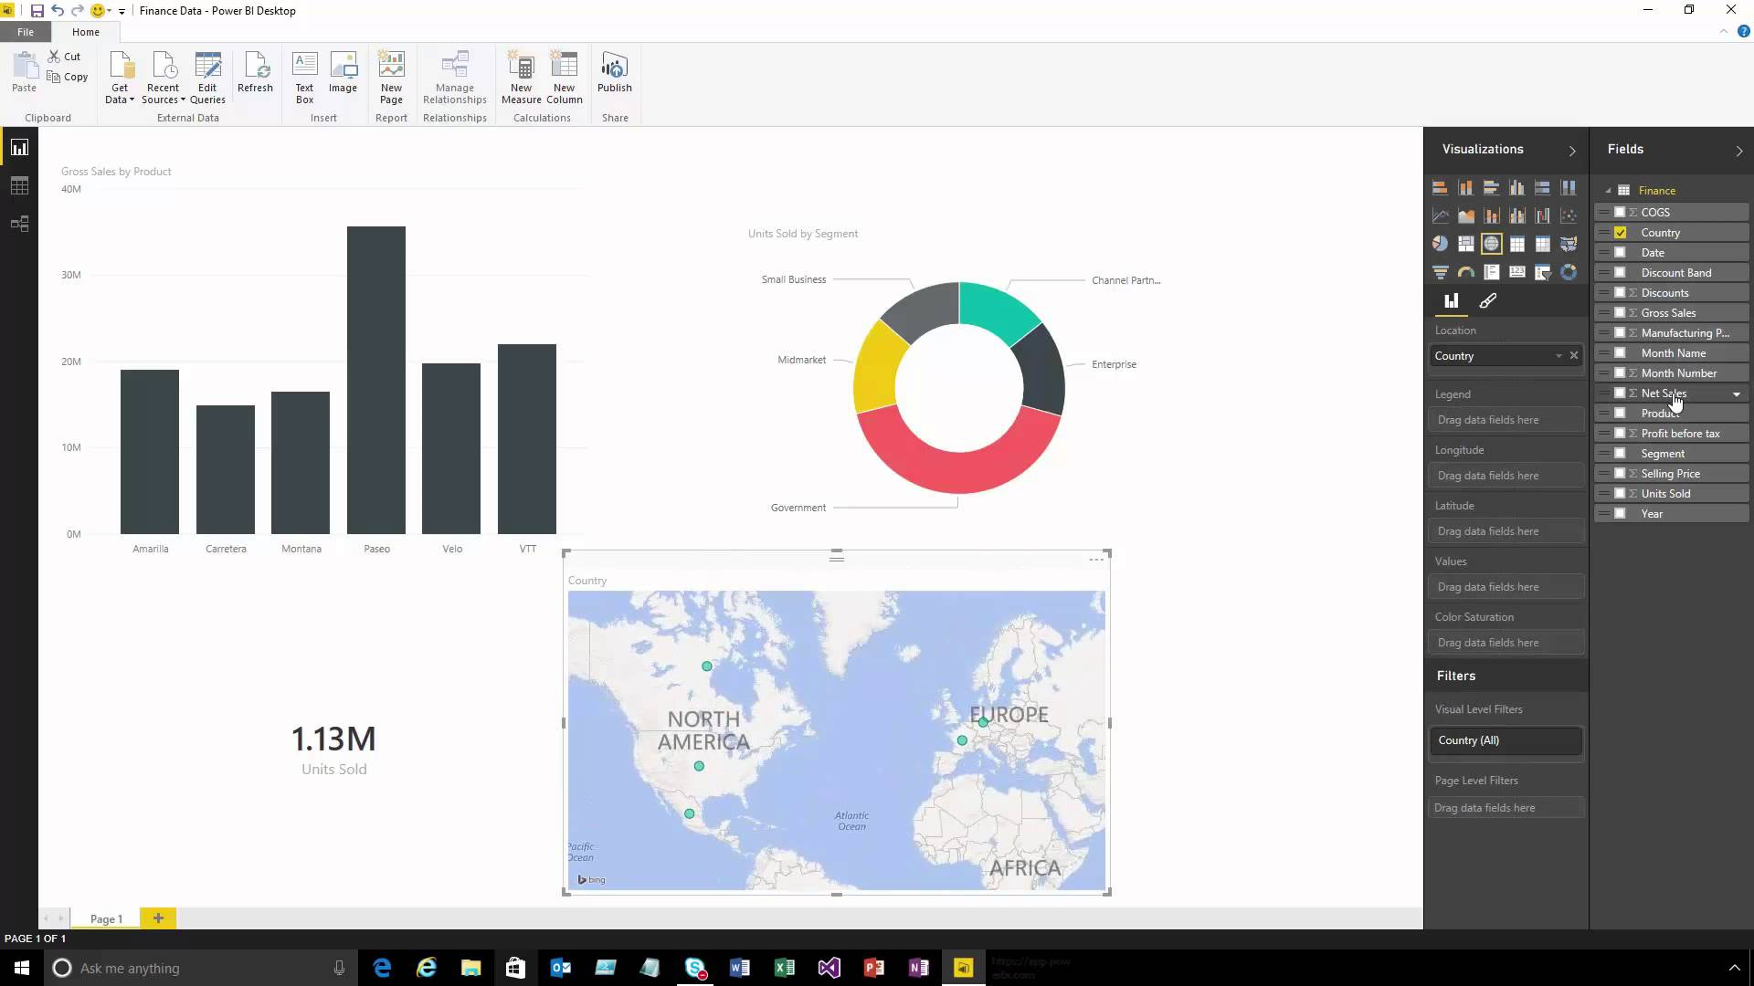
1. Bring Data In

Slide 10
2. Create Your Reports

Slide 11

3. Publish Your Reports

Slide 12
4. Interact With Your Reports

Slide 14
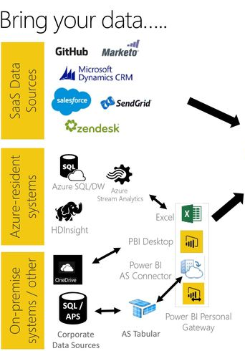

Slide 15
Dashboard Vs Report
Dashboard: General
Stephen Few‘s definition of Dashboard: A dashboard is a visual display of the most important information needed to achieve one or more objectives; consolidated and arranged on a single screen so the information can be monitored at a glance.
Report: General
A Report on the other hand is any informational work. This information can be at any format. Table, Chart, text, number or anything else.
Power BI Report
Power BI Report is combination of multiple visual elements (charts, texts, values…) on a page that can be inter-related with each other. Data visualized in the report can be sliced and diced with slicers. Power BI report is fully interactive from user. and It can be filtered based on some criteria.
Power BI Dashboard
Power BI Dashboard is a high level view of some of key KPIs of one or more reports. Dashboard is a day-to-day view of KPIs, and provide the navigation point to the detailed reports. Power BI Dashboard isn’t built for slicing and dicing.
You can see that definition of Power BI Dashboard and Report fits into the general definition of these two component we’ve had earlier. Now let’s look closer at these two.

Slide 16
Dashboard Vs Report Contd..
Reports in Power BI can have multiple pages. In each page there might be multiple visualization elements. Slicing and dicing, hovering and highlighting is possible in the Report. We can drill down through a hierarchical data structure, or select a particular column in a column chart and see the related data to it in other visualization elements. All of these means Report in Power BI is for slicing and dicing. Report built for end users to play with different handles (slicers or visuals or filters), and achieve what they want
Power BI Report
Slicers
Multi-Pages
Interactivity
Drill Down/Up
Publish to Web
Explore Data
Power BI Dashboard
Automatic Refresh
Sharing
Customization by User is Easy
Featured Dashboard
Power Q&A
Real-time Monitoring
Alerts
Related Insights

Slide 17
Dashboard Vs Report Contd..
Bottomline:
Dashboard is day-to-day single page view of main KPIs, which can be refreshed automatically and can visualize real-time events. Dashboard can be used to navigate to reports.
Reports are interactive data visualization elements that can be used by users to slice and dice, highlight and interact with to investigate numbers and insight more in details.
For a great visualization solution with Power BI you would need both, these are complements of each other, not replace.

Slide 18
Licensing Models
Compare the licenses
Power BI Free: No sharing except public with no security
Power BI Pro: Standard pricing or part of O365 Sharing, Apps, consuming and Workspaces
Power BI Embedded: Page renders (See next slide)
Power BI Premium: Based on nodes
Power BI Report Server Only licensing

Slide 19
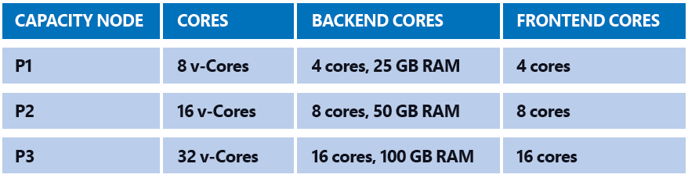
Licensing – Power BI Premium Pricing
Power BI Pro will be expensive for a large user base, and embedded needs a constant maintenance by a web developer. If you have a large user base of several thousand,
then Power BI Premium is the best licensing option for you. Since in this scenario buying a license for all the people is not feasible.
Power BI Premium is designed for large user base scenario where the size of data is huge.
Power BI Premium is not per user, it is per node. In Power BI premium you pay for nodes which have dedicated capacity and resources.
P1 nodes start at $3K-$5K. https://powerbi.microsoft.com/en-us/calculator/

Slide 20
Sharing
Basic Sharing
Workspace
Power BI App
Publish to Web
Embed in SharePoint online
Power BI Embedded
Secure Embed

Slide 21
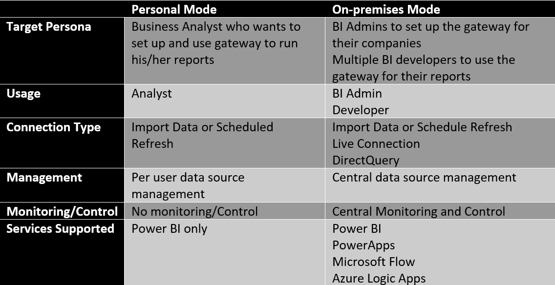
Gateways –Different modes

Slide 22
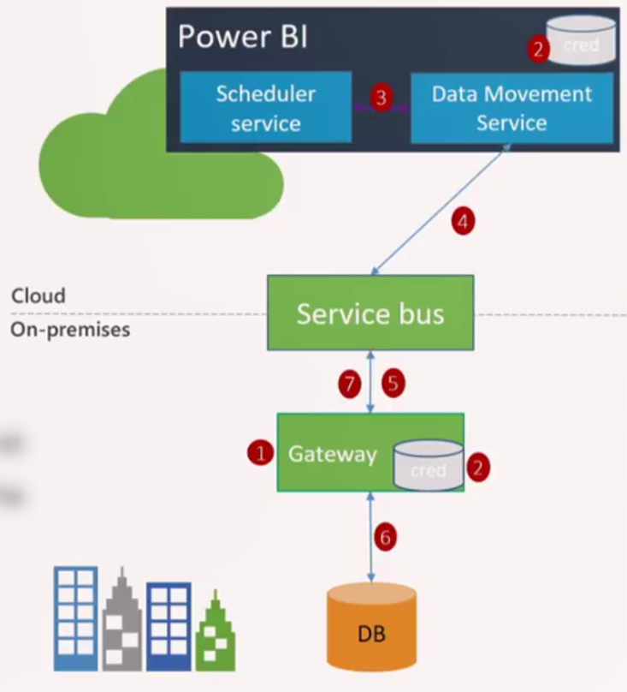
Gateways –Architecture

Slide 23
Gateways –Architecture
How many gateways is required?
One gateway should be enough for many situations. However, there are sometimes that you would get more benefit with having more gateways. As an example, if you have a gateway that used for scheduled data refresh, and the same gateway is used for a Live Connection, then you get slow performance for the live connection if there is a scheduled data refresh in process at that time. So, in this scenario, you might consider having one gateway for your Live Connection, and another one for a scheduled refresh.
The gateway can be installed only on 64bit Windows operating system.
If you install gateway in personal mode, and then you decide to install on-premises recommended gateway on that machine, you need to clean the registry. This process is not an easy process to go through. My recommendation is to choose the version of gateway that you need on that machine carefully. If this is a server, then I highly recommend installing on-premises recommended gateway on it rather than personal.

Slide 24
Power BI Synchronization
Databases in the Cloud - From the Power BI service, you can connect live to Azure SQL Database, Azure SQL Data Warehouse, Spark on Azure HD Insight, and SQL Server Analysis Services using DirectQuery. Connections from Power BI to these databases are live, that is, when you've connected to say an Azure SQL Database, and you begin exploring its data by creating reports in Power BI, anytime you slice your data or add another field to a visualization, a query is made right to the database. For the rest it depends on the data source
Files on One-Drive or SharePoint – Data is synchronized every hour.

Slide 25
Connection Types in Power BI
Automatic Refresh: Files residing on OneDrive refresh every hour. For online sources it is usually once a day
Power BI Import: Based on Analysis services, brings the data in and caches
Power BI Service: When deployed, the data resides on the Azure cloud. . Refreshed via Gateways for on premise data sources.
Direct query: Connected to the Data source directly. Has limitations on the DAX and Visuals as well as the Data source.
Mixed: A combination of Import and Direct
Live connection: Supported by Azure Analysis services

Slide 26
Modeling Best practices
Tables or columns that are unused should be removed if possible.
Avoid distinct counts on fields with high cardinality – that is, millions of distinct values.
Take steps to avoid fields with unnecessary precision and high cardinality. For example, you could split highly unique datetime values into separate columns – for example, month, year, date, etc. Or, where possible, use rounding on high-precision fields to decrease cardinality
Use integers instead of strings, where possible.
Be wary of DAX functions, which need to test every row in a table – for example, RANKX – in the worst case, these functions can exponentially increase run-time and memory requirements given linear increases in table size.
When connecting to data sources via DirectQuery, consider indexing columns that are commonly filtered or sliced again – this will greatly improve report responsiveness.

Slide 27
Getting started
https://powerbi.microsoft.com/en-us/diad/
Download Power BI Desktop
Sign-up for a trail license
Several blogs and books available in the help section of Power BI Desktop
Local Events:
SQL Saturdays
Dashboard in a day
So Cal Power platform user group

